Slide 1
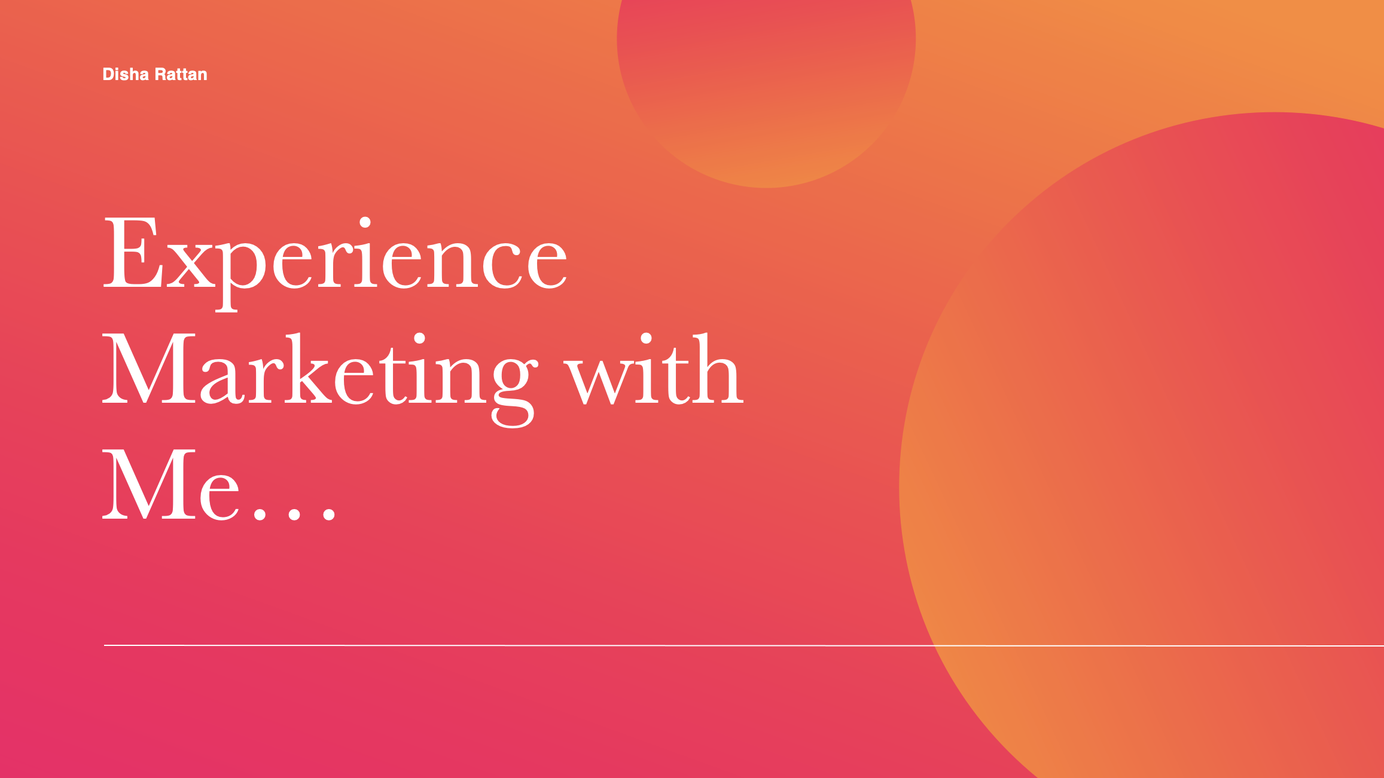

Slide 2
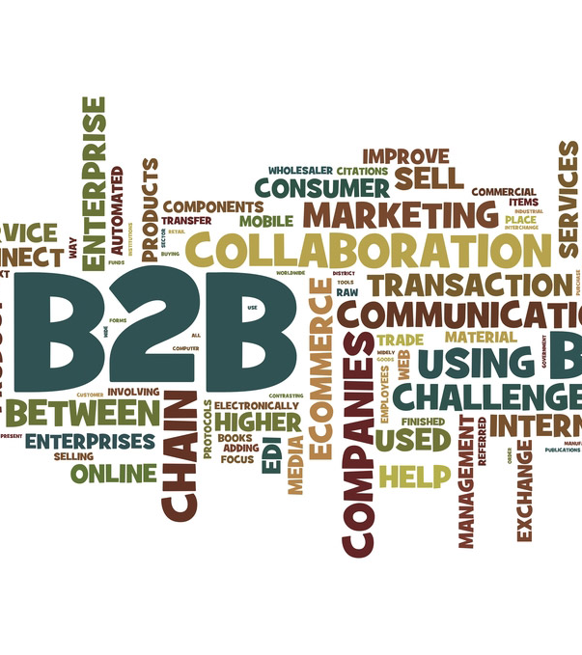
Disha Rattan
“Good marketing makes the company look smart, great marketing makes the customer look smart!”
We may create campaigns, content, and brilliant marketing tactics to sell our product to the audience, but we must never forget that, at the end of the day, we are selling to a human being, and as we know, we all want to be the smartest person in the room.
I follow the above quote in practice, and this is reflected in my marketing tactics, which employ innovative marketing strategies to promote the product or the company in the simplest way possible, allowing customers to form a connection with the brand rather than thinking, 'This is not for me!'.
Marketing with purpose and passion

Slide 3
Disha Rattan
About Me
I began my career in banking but quickly realised that it was not the appropriate path for me. I've always been good at creative work and wanted to explore professional opportunities in a sector that would enable me to employ my creative abilities, so I switched to marketing. I worked as a freelancer to learn the intricacies of marketing before joining POPxo as a community associate. Although my work was primarily focused on community building, due to my proactive participation, ideas, dedication, and enthusiasm, I included in the projects with the product, growth marketing, and public relations teams on a variety of projects, the most notable of which were the company's digital revamp and major e-commerce deals with Amazon and Flipkart. After that, I chose to work with some local businesses, and I took on marketing responsibilities for two local jewellery brands.
I gained knowledge and hands-on experience in online and offline marketing tactics, event marketing, content marketing, email marketing, social media marketing, SEO, UX/UI design and wire-framing, and PR strategies due to all of these experiences.
I then chose to pursue an MSc in Marketing at Trinity College Dublin, one of Europe's most prestigious universities, to obtain a theoretical grasp of important marketing ideas and marketing management.
Aside from working and studying, I like reading, hiking, socialising, cooking, and binge-watching new Netflix series.

Slide 4

Disha Rattan
Why Hire Me?
It's not only my experience leading successful marketing and digital marketing campaigns, or my people skills, that have enabled me to build strong connections with developers, vendors, senior management, companies. But I'm also enthusiastic about this sector and determined to produce high-quality work. My work brings me joy and pride. My experience as a marketer has provided me with a solid understanding of how businesses manage their marketing activities and the challenges they confront. My strong analytical skills, thirst for knowledge, and desire to put information into action have helped me succeed in all the marketing projects and roles that I have taken up.
I have two and a half years of marketing experience in which I handled event marketing, public relations, content marketing, SEO, PPC, digital marketing, offline marketing, and print media. I helped my clients build solid B2B connections and handled their marketing budgeting, strategy formulation, and forecasting for future campaigns ideas.
I have managed and trained interns and new workers. I have directed several successful marketing and digital marketing projects, some of which are included here:
PR Campaign that led to an increase in the firm's outreach by 700% and helped them build strong B2B connections.
Community engagement campaign that led to a rise in engagement by 1000% and increased consumer retention by 450%.
Brand awareness campaign that helped my client make their brand visible online and increased their social media following by 800%.
I also helped increase my department's efficiency by helping create an in-house tool to automate repetitive tasks that saved around 2 hours' worth of employees' time and effort and helped them maintain a good work-life balance.
My interpersonal skills have been honed throughout my career, allowing me to cultivate good working connections with managers, clients, colleagues, and customers. Hence, I am well equipped to work on high-profile, cross-departmental initiatives and foster strong relationships with clients. In addition, I feel my patience and multitasking abilities are second to none and would go a long way toward making me one of your finest hires.

Slide 5





Disha Rattan
Skills as a Marketer
Marketing is the only industry that demands a person to be analytical, strategic, excellent with numbers and forecasting, and technologically proficient and up-to-date. So basically, you have to be an all-rounder with a thirst to learn more!
Strategy Development
Demand Generation
Content
Campaigns
Market Research
Develop and execute strategies to stay ahead of the competition
Increase demand by boosting brand/product awareness among existing and future customers
Create a content strategy and calendar to support the company's goals, enhance SEO, and create marketing, advertising, and website material and blog posts
Put together creatives and content to deliver incredible campaigns, and come up with future campaign ideas to convey the company's message
Search for and discover possible leads or demographics of your target audience.
Marketing with purpose and passion.

Slide 6





Disha Rattan
Skills as a Marketer
Marketing is the only industry that demands a person to be analytical, strategic, excellent with numbers and forecasting, and technologically proficient and up-to-date. So basically, you have to be an all-rounder with a thirst to learn more!
Events
Communication
Budgets
Cross-Functional
Coordination
Analysing & Forecasting
Planning and producing events ranging from webinars to product launches
Develop connections with external vendors, influencers, agencies, and businesses to market your own company
Allocate and manage budgets for various marketing campaigns and programs
Plan promotional marketing campaigns in conjunction with sales, marketing, advertising, product design, and product development teams
Analysing the impact of existing campaigns using analytics reports and making changes to come up with marketing ideas that have a better probability of succeeding in the future
Marketing with purpose and passion.

Slide 7
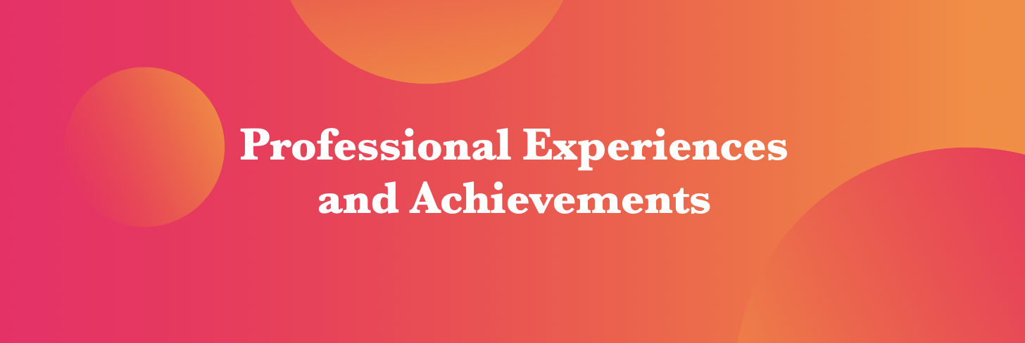
Disha Rattan
Marketing/Digital
Marketing Strategies

Slide 8
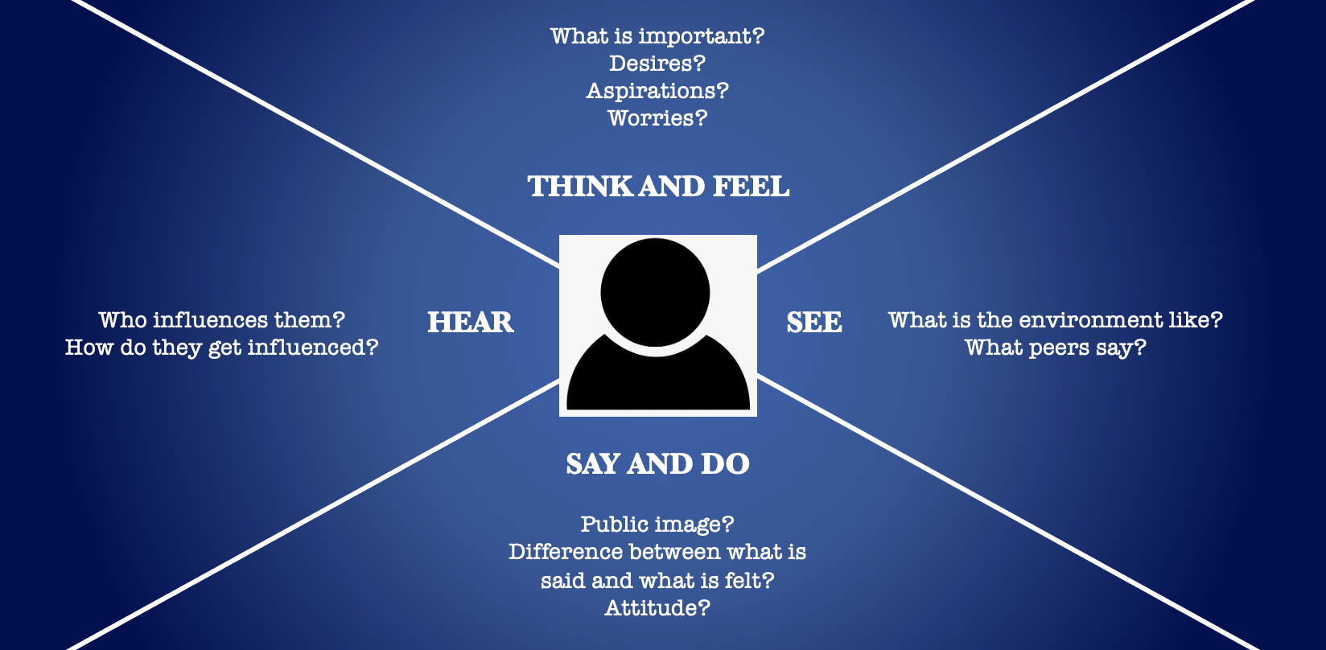
Disha Rattan
Empathy Map
The following slides contain the empathy maps for the companies that I worked at. An empathy map assists teams in better understanding their consumers. Much like a user person, an empathy map represents a group of users or a company.
Marketing and Social Media Specialist
HC Sons
Community Associate
POPxo
Marketing Associate
Events Planning

Slide 9
Disha Rattan
Marketing and Social Media Specialist,
HC Sons
They wanted to compete digitally but were disappointed by their poor rate of online development. They intended to enhance company earnings by establishing an online presence.
Think and Feel
They received a lot of advice from their friends, family, and coworkers. Unfortunately, their only alternative was to imitate the digital methods used by other businesses.
They noticed significant growth among their competitors as a result of their competitors' businesses going online. As a result, HC Sons' morale was low since they couldn't catch up on the online front.
Hear
See
Say and Do
They discussed their plans with numerous freelancers regularly, but nothing appeared to work.

Slide 10


Disha Rattan
GAIN:
HC Sons wanted to get their online business off to a good start to develop their client base, compete online, and boost profitability.
PAIN:
HC Sons had no idea what digital marketing approach would work best for their business model because none of the general methods worked.

Slide 11
Disha Rattan
Community Associate,
POPxo
POPxo had recently launched their community part of the business and was in the process of extensively revamping their online platforms in preparation for their funding round. They desired to enhance community participation to boost brand exposure, conversion rate, customer retention, and online revenues.
Think and Feel
They received a lot of advice from their investors about how a bigger community will benefit them in the long run and how they should redesign their online platform to make it more appealing and user-friendly.
POPxo's competitors saw 10x revenues due to a large community. A robust community also made POPxo's competitors' WOM and e-WOM marketing efforts considerably more cost-effective and less time-consuming.
Hear
See
Say and Do
They intended to invest more money in community engagement activities to gain a large following.

Slide 12
Disha Rattan
GAIN:
POPxo was searching for a solution and a team to assist them in increasing their user engagement and improve their online image.
PAIN:
Because of their large and diverse community, POPxo's rivals could reach their business goals at half the cost and in half the time.

Slide 13
Disha Rattan
Marketing Associate,
Event Planning
They were new to the industry and wanted to make connections with vendors, contractors, and businesses to help them grow and increase profits.
Think and Feel
They received a lot of advice on how it was more important to have a strong offline presence in their business area, but they observed sluggish growth due to no solid PR and digital marketing strategy.
They observed their competitors prospering due to excellent public relations and digital marketing strategies and wanted to fill that void for their company as well.
Hear
See
Say and Do
They spent the majority of their time attempting to expand their offline business, and as a result, their PR and digital operations suffered greatly.

Slide 14
Disha Rattan
GAIN:
They had slow growth and seasonal slumps due to a lack of digital presence and little to no public relations strategy.
PAIN:
They intended to improve their social media and digital marketing tactics and have a solid public relations plan in place to have high-quality external relationships.

Slide 15
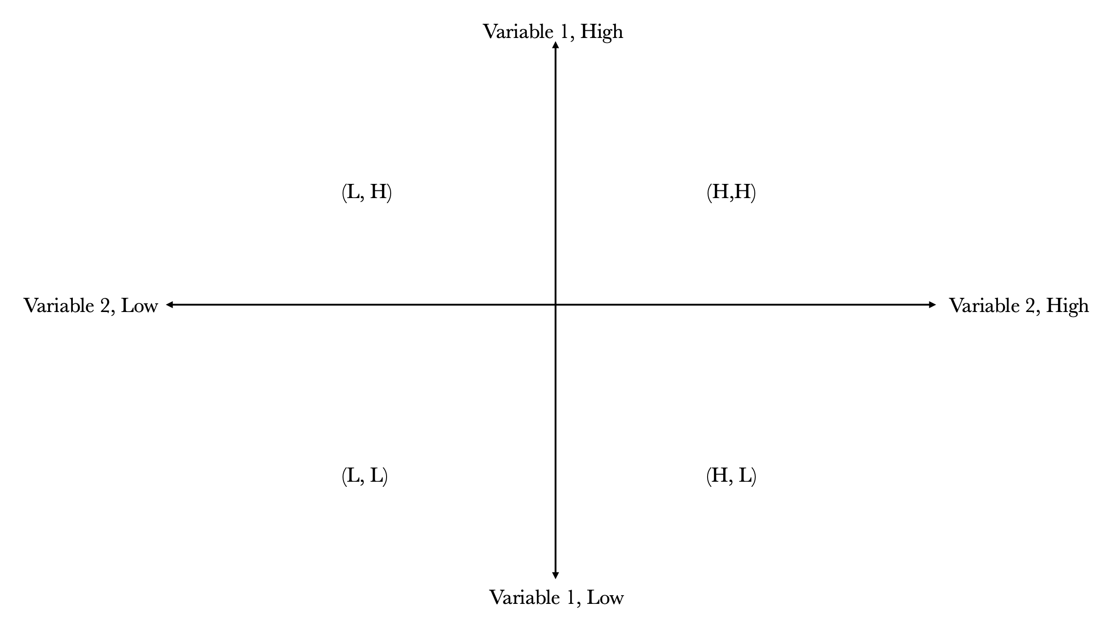
Disha Rattan
Position Mapping
This section contains the before and after position mapping of this firms that I have worked for to show the significant changes in their revenues and growth.
Positioning maps indicate where existing products and services are positioned in the market, allowing the company to select where they want their product or service to be in the future.

Slide 16
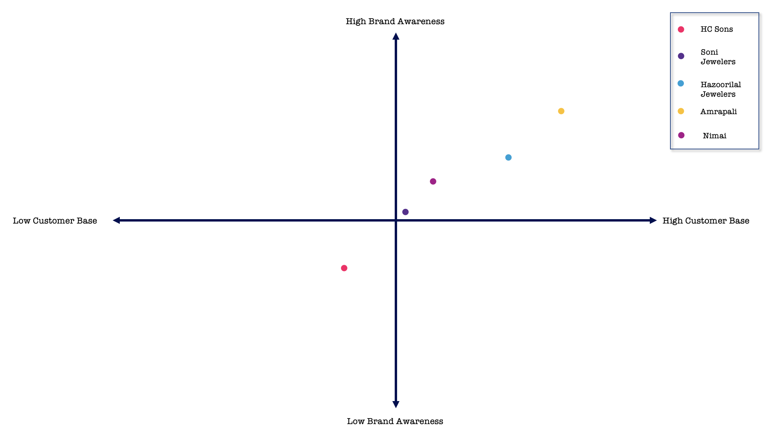
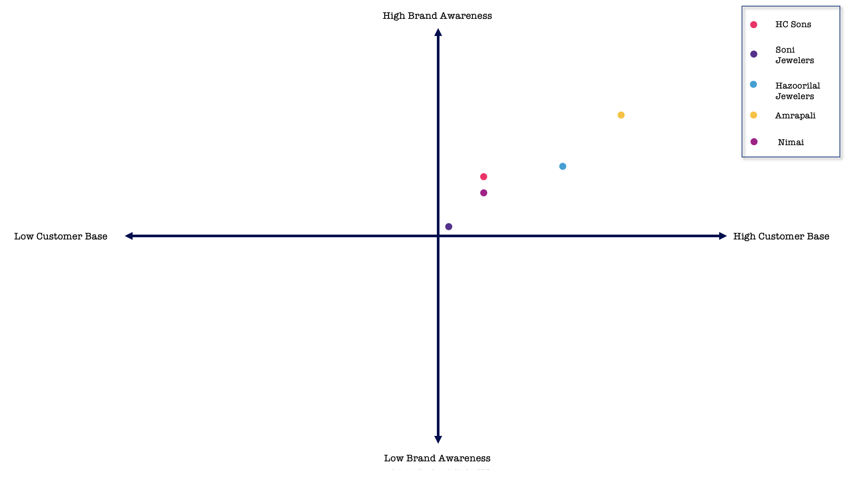
Disha Rattan
HC Sons
Before
After
#2 Marketing

Slide 17
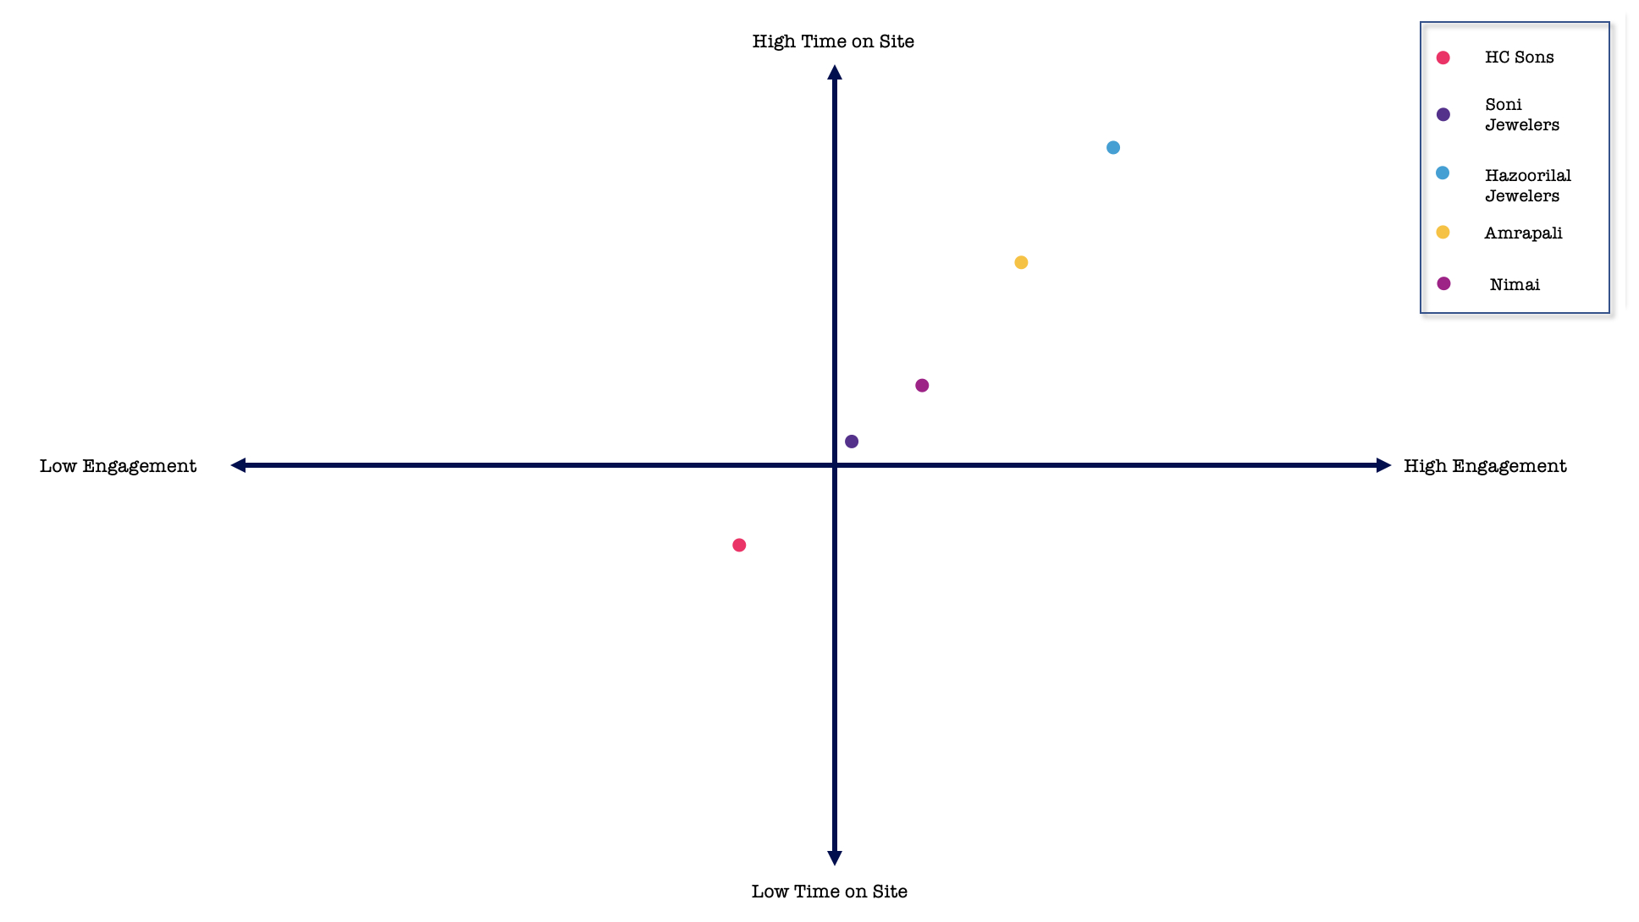
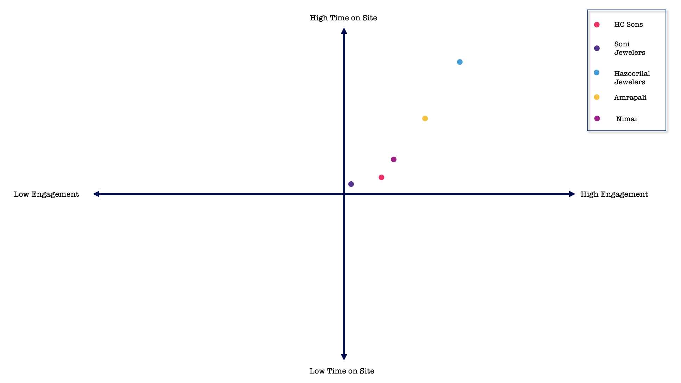
Disha Rattan
HC Sons
Before
After
#2 Marketing

Slide 18
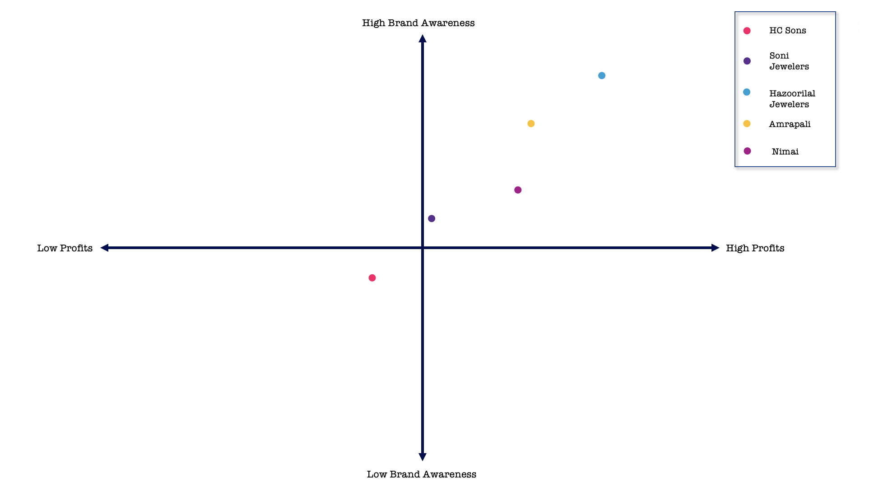
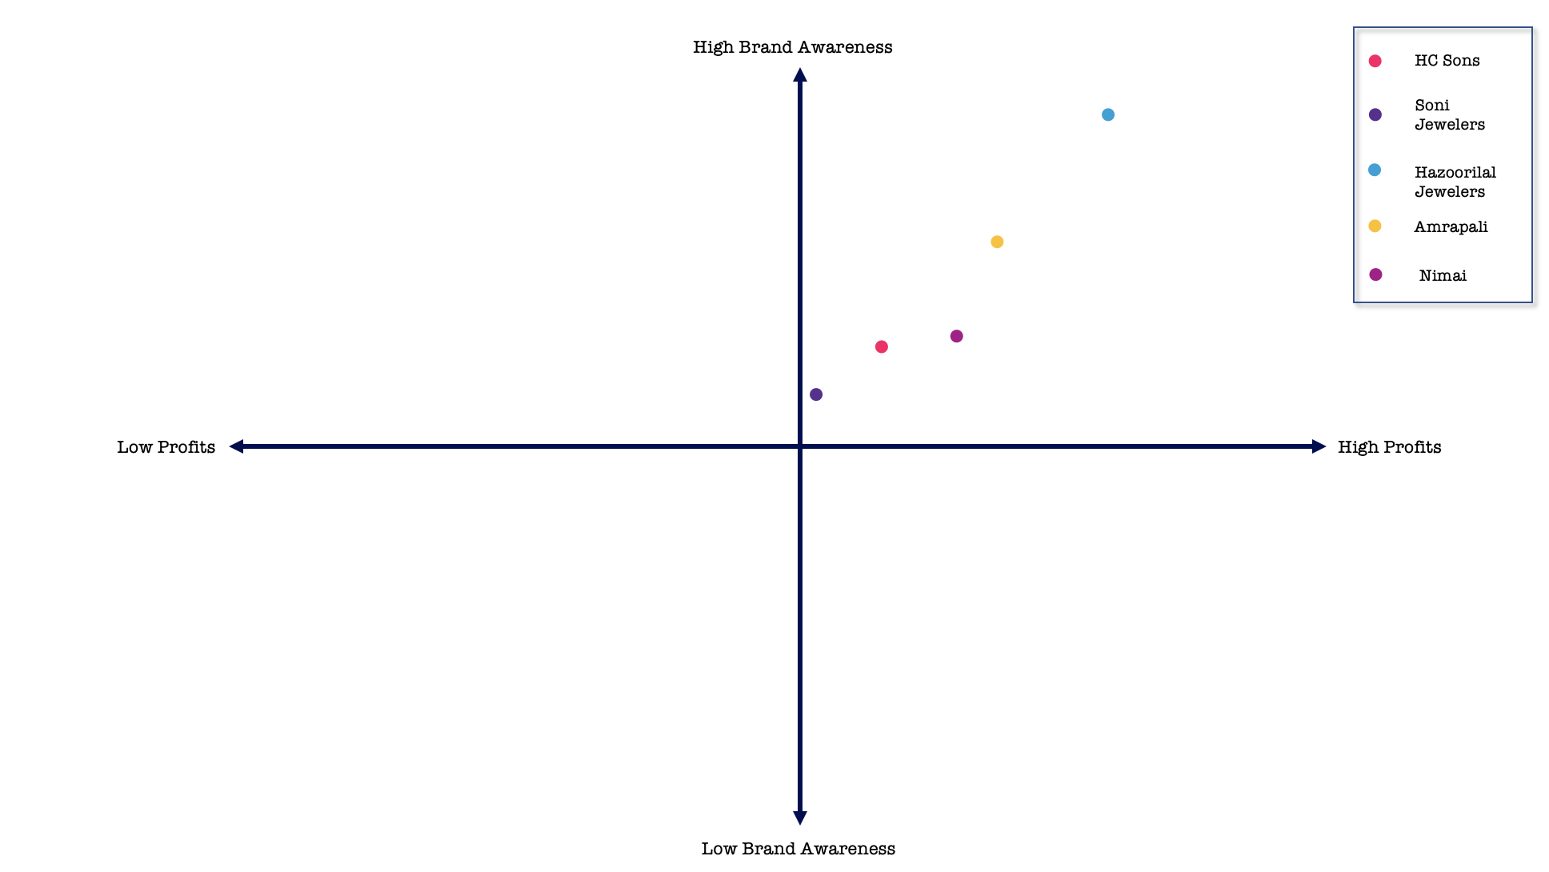
Disha Rattan
HC Sons
Before
After
#2 Marketing

Slide 19
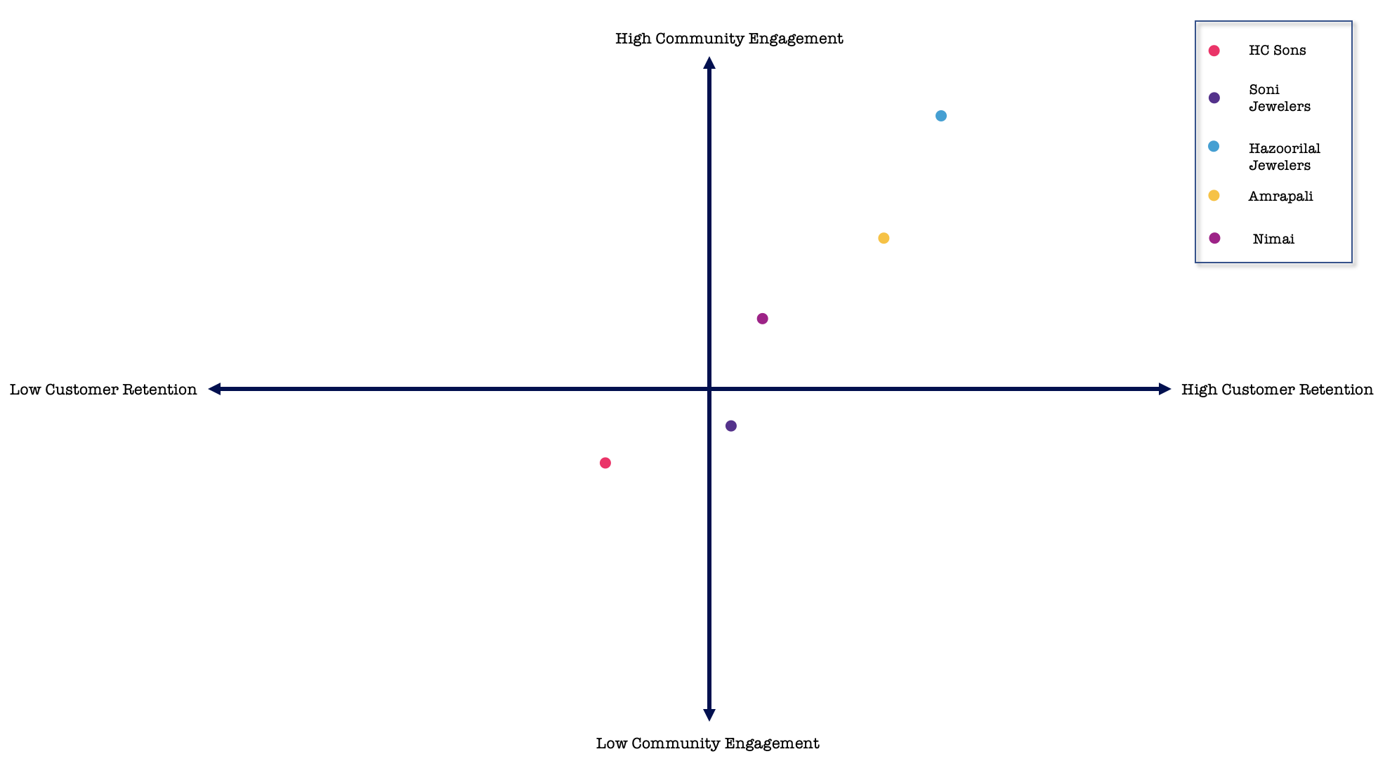
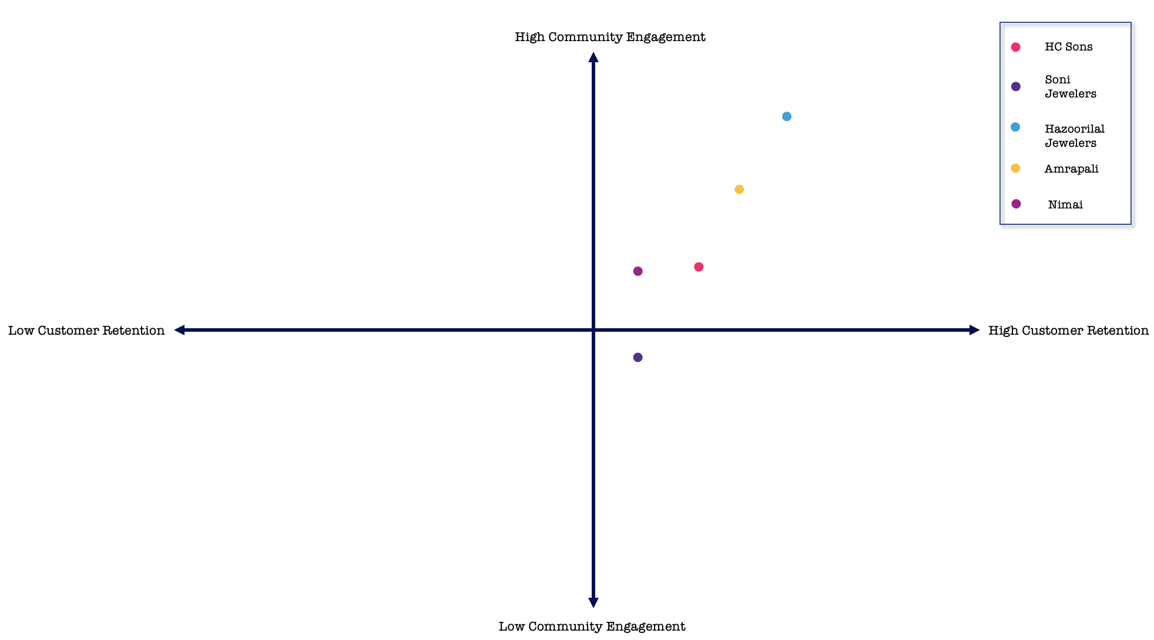
Disha Rattan
HC Sons
Before
After
#2 Marketing

Slide 20
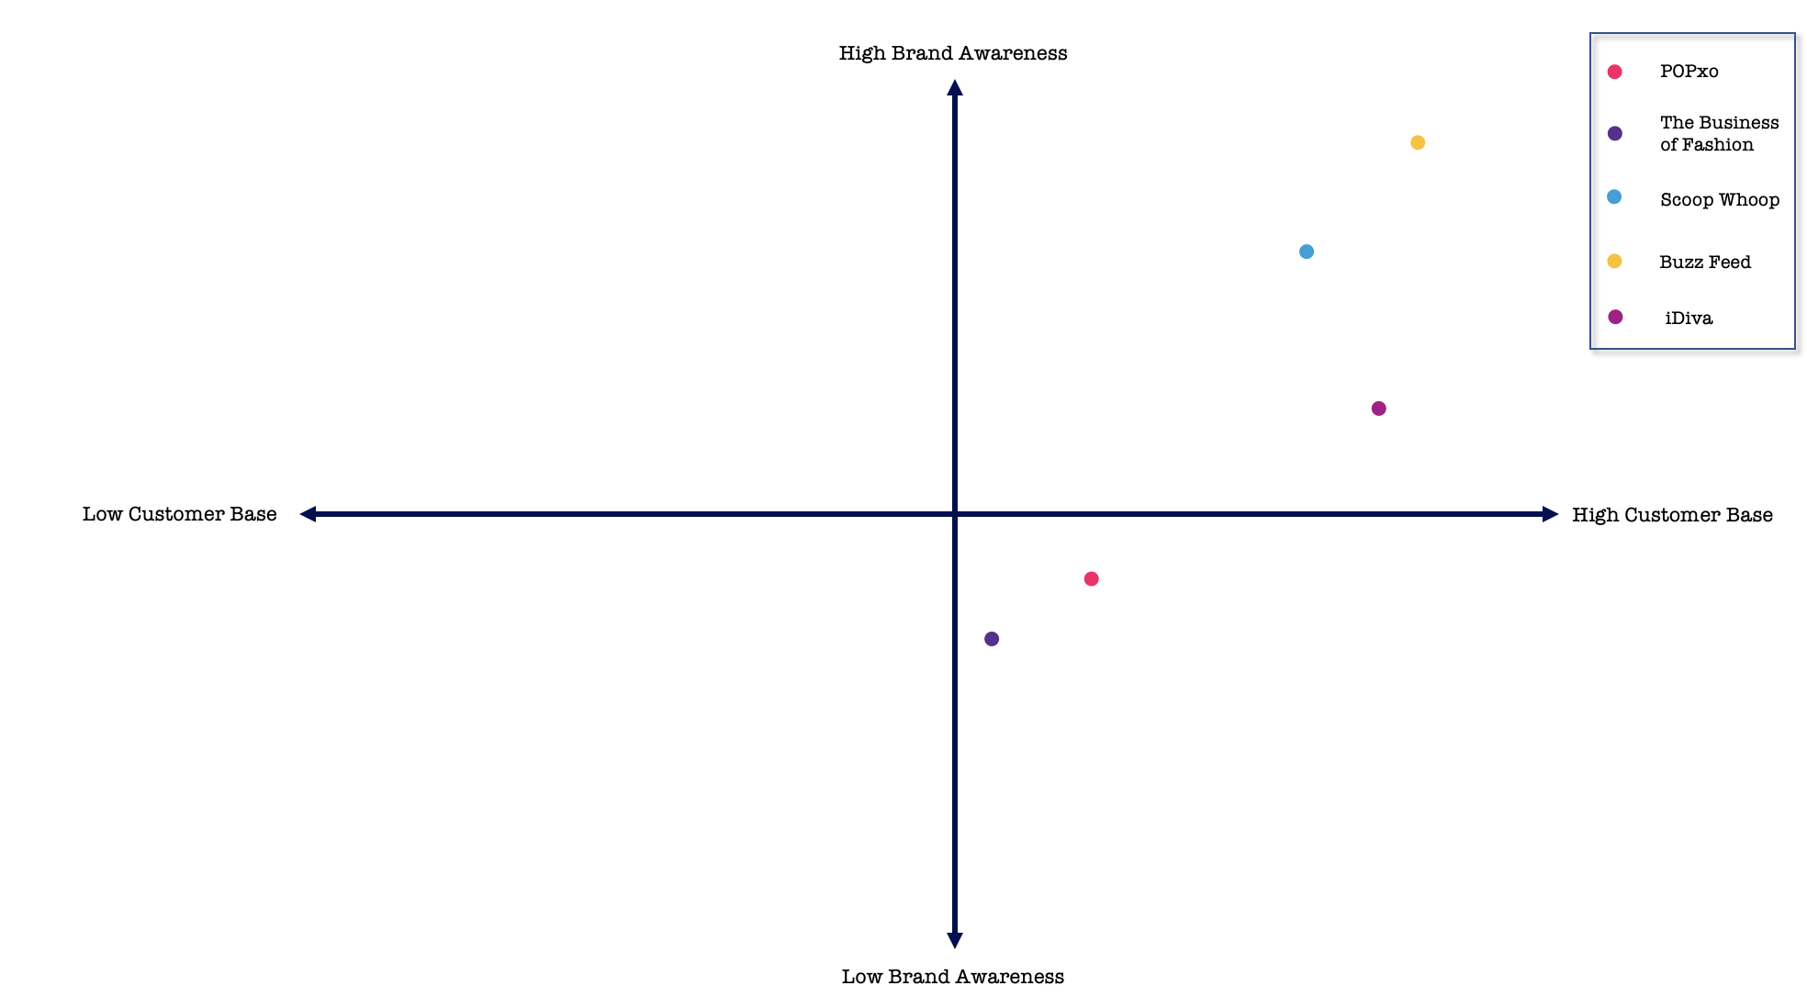
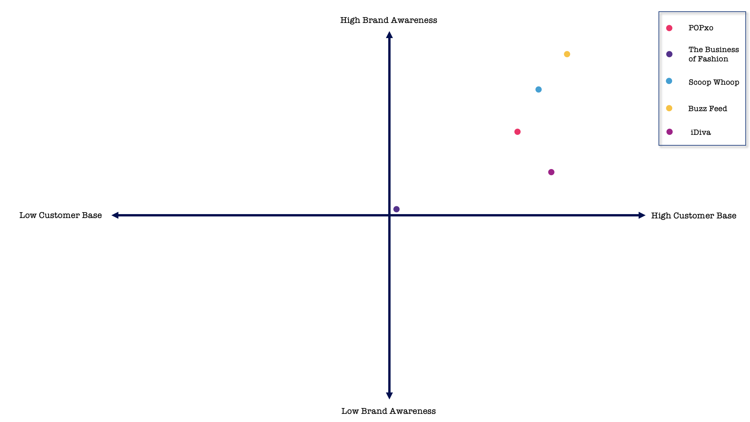
Disha Rattan
POPxo
Before
After
#2 Marketing

Slide 21
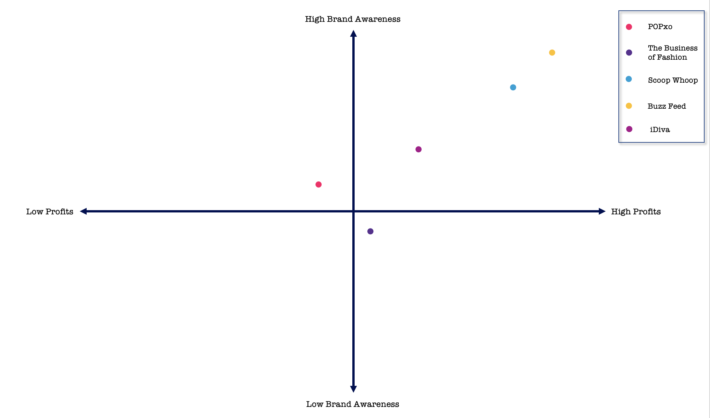
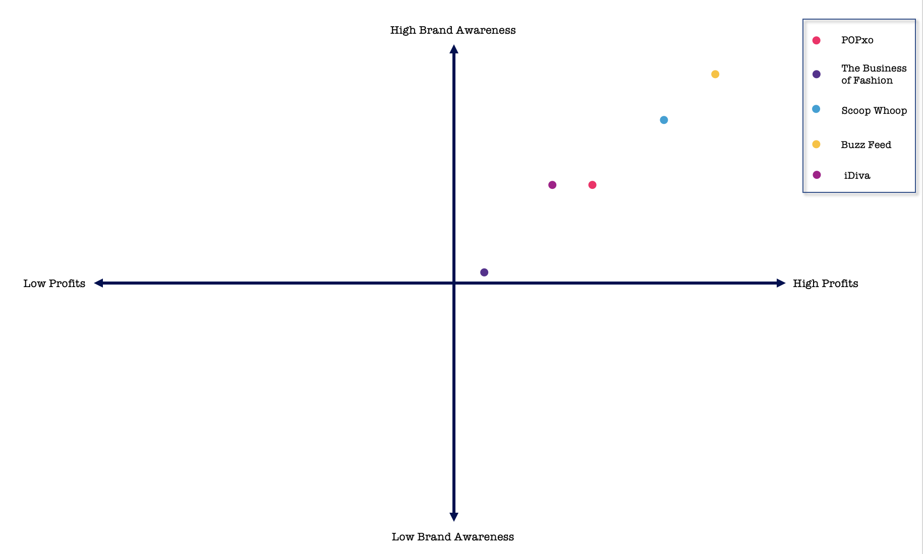
Disha Rattan
POPxo
Before
After
#2 Marketing

Slide 22
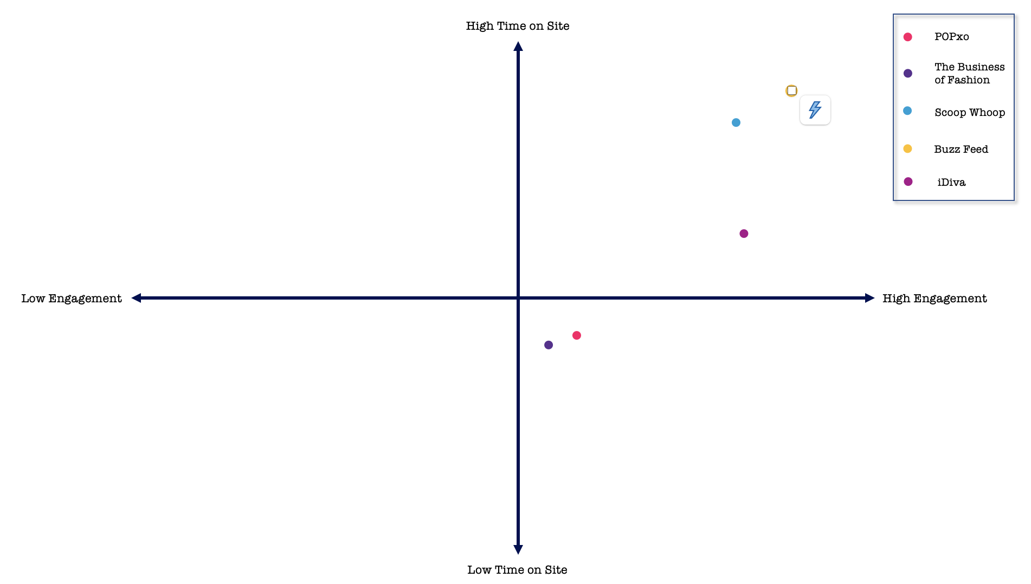
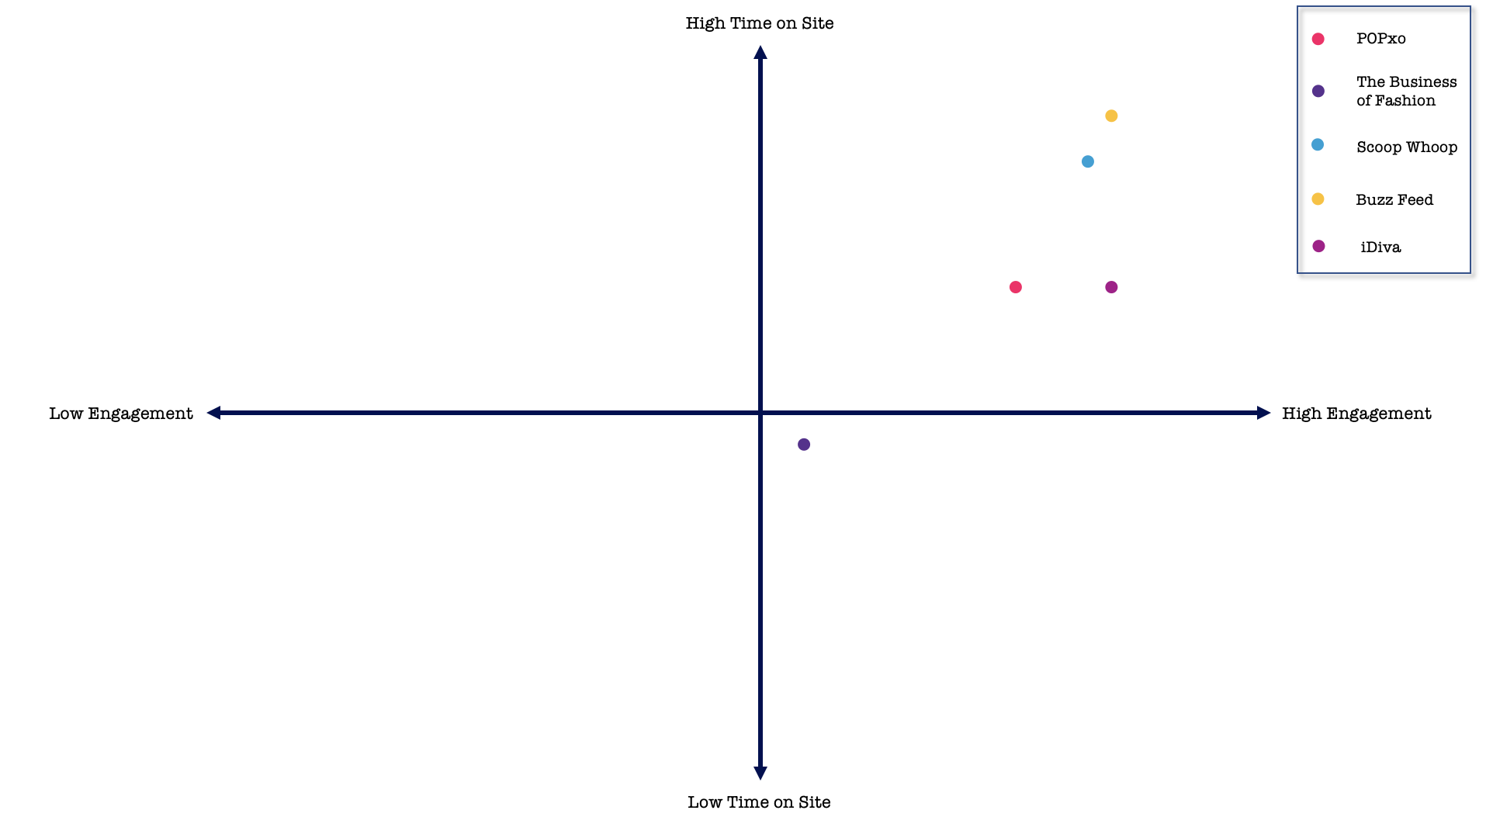
Disha Rattan
POPxo
Before
After
#2 Marketing

Slide 23
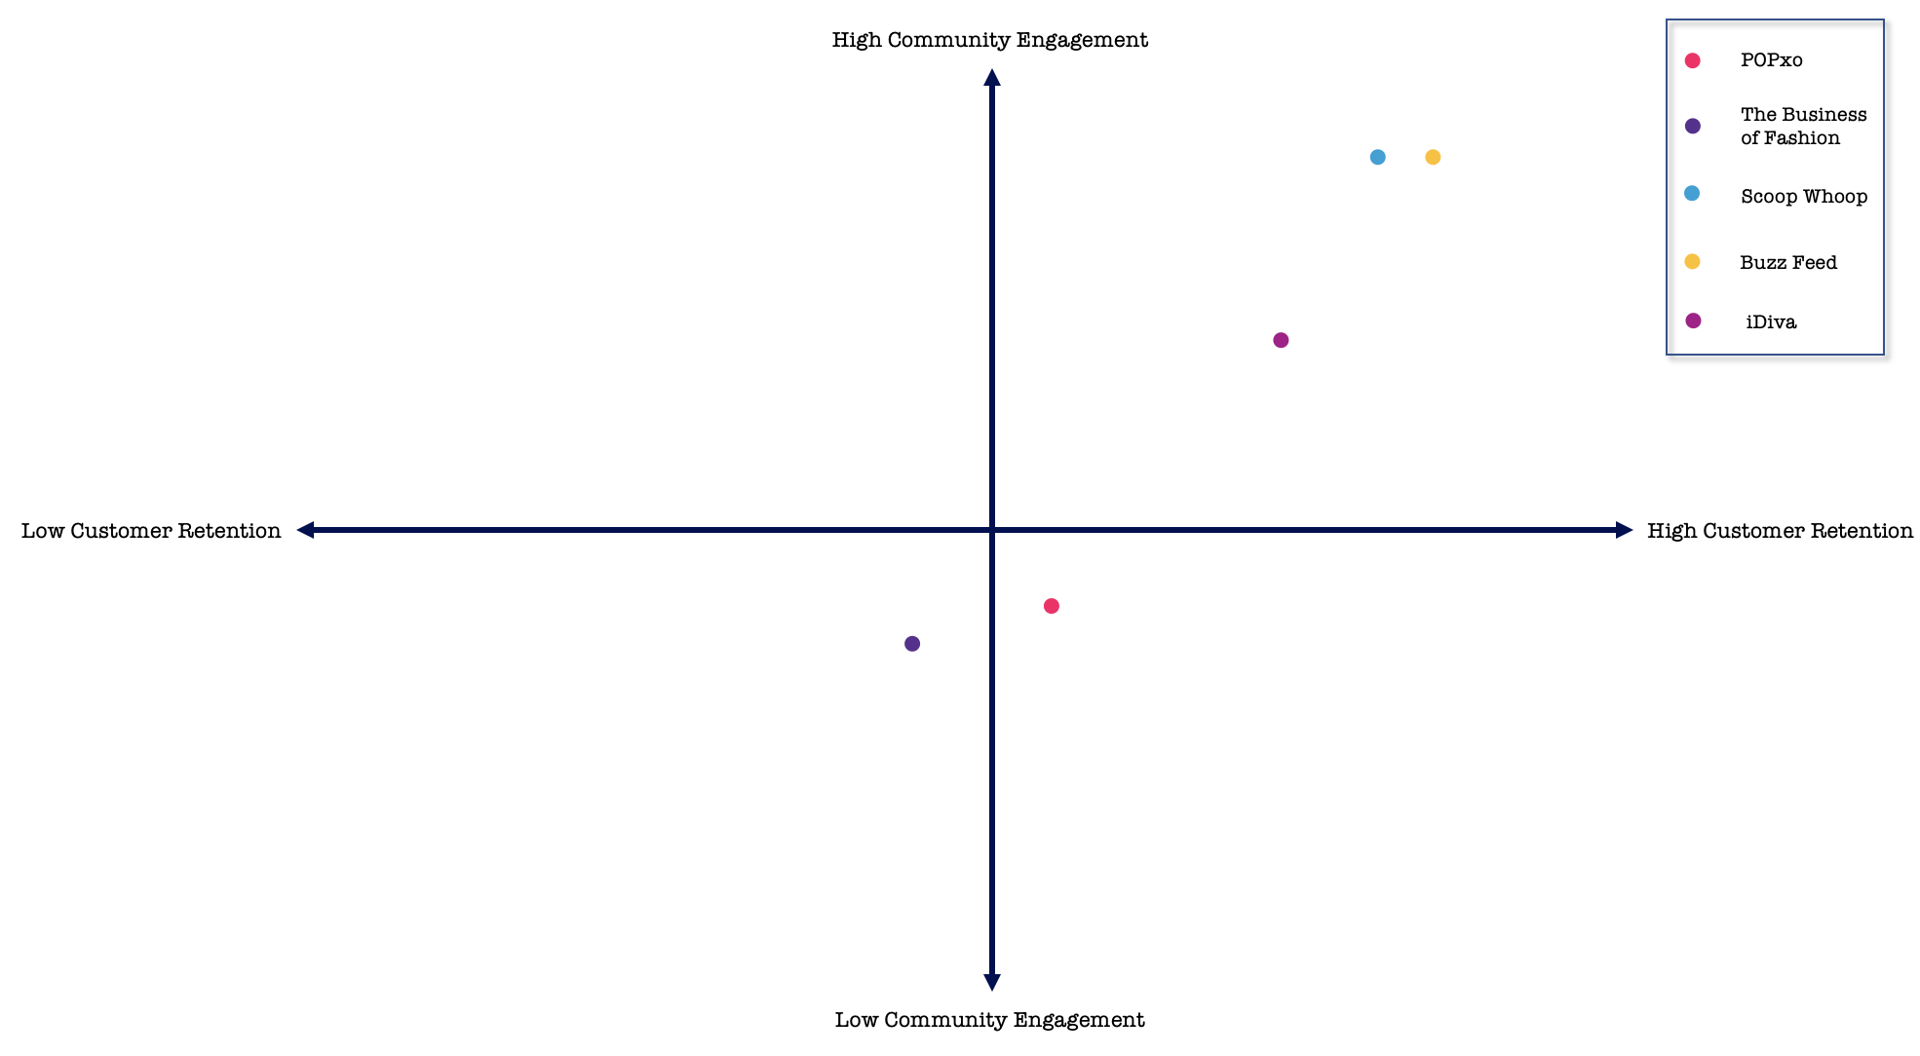
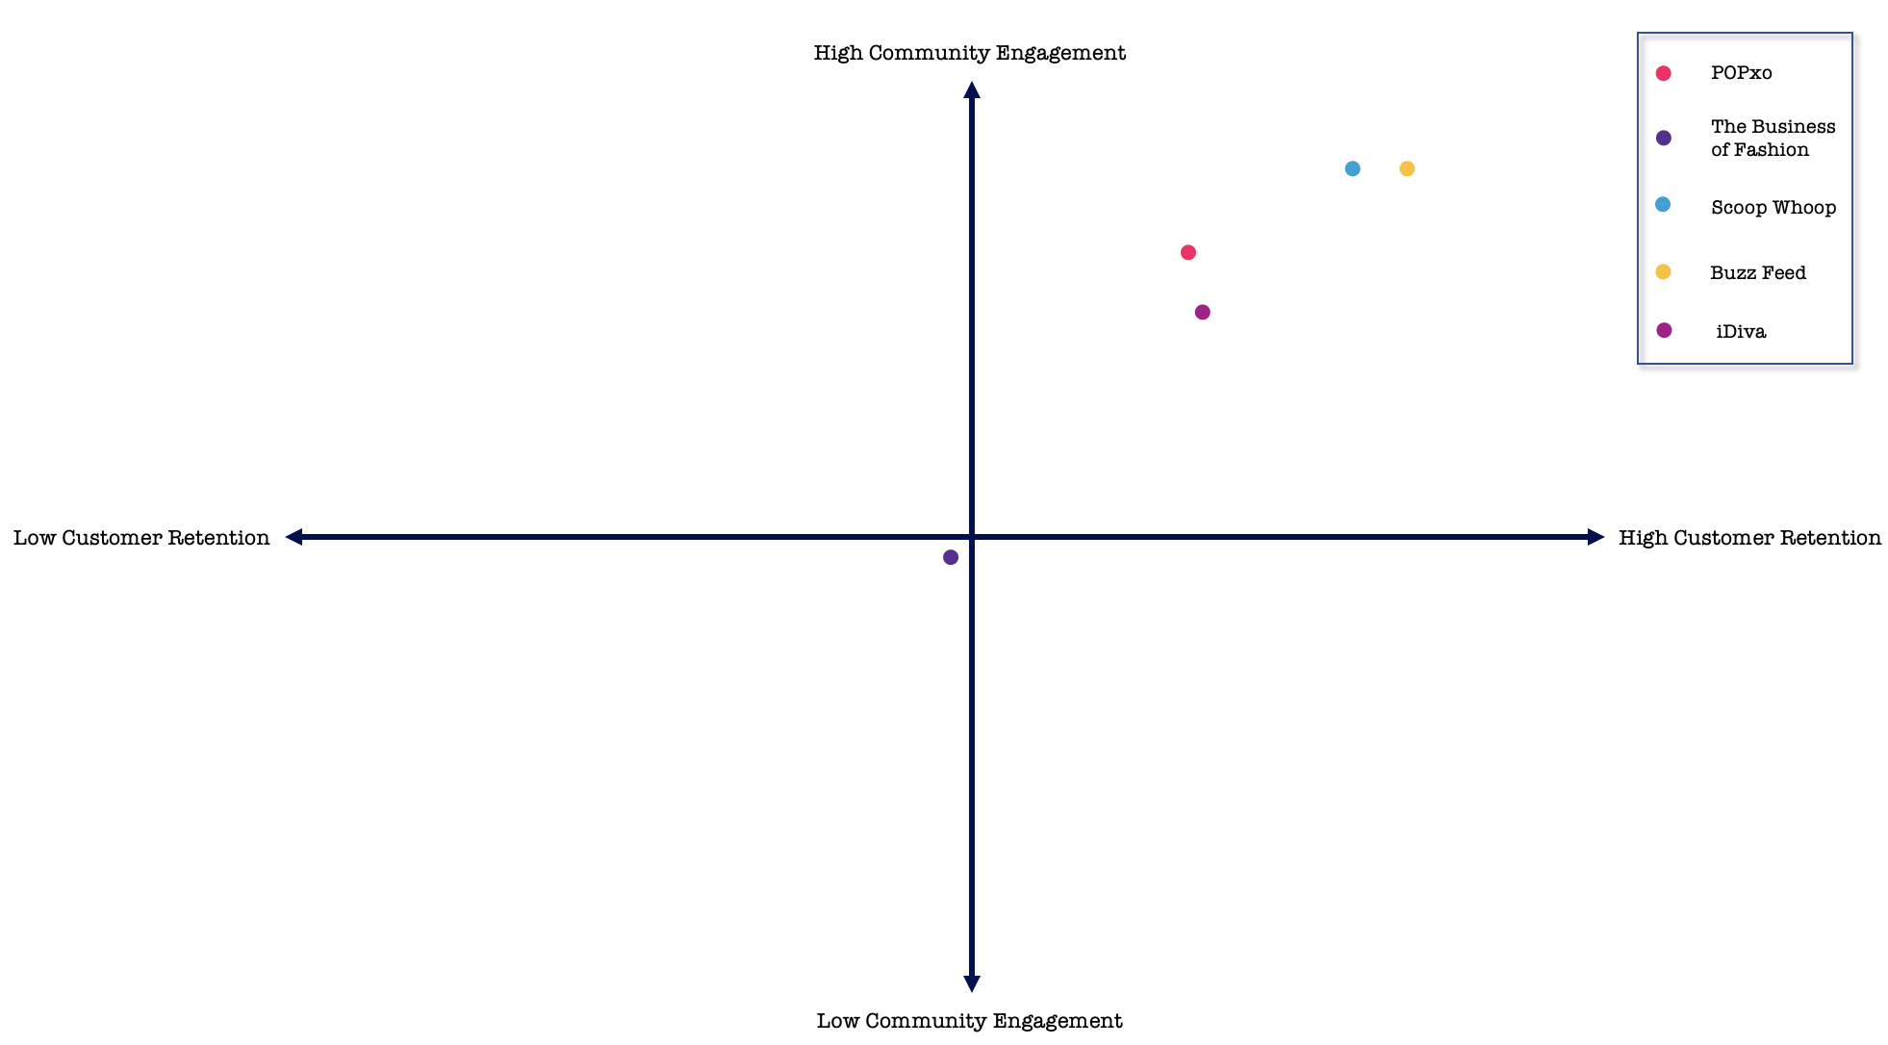
Disha Rattan
POPxo
Before
After
#2 Marketing

Slide 24
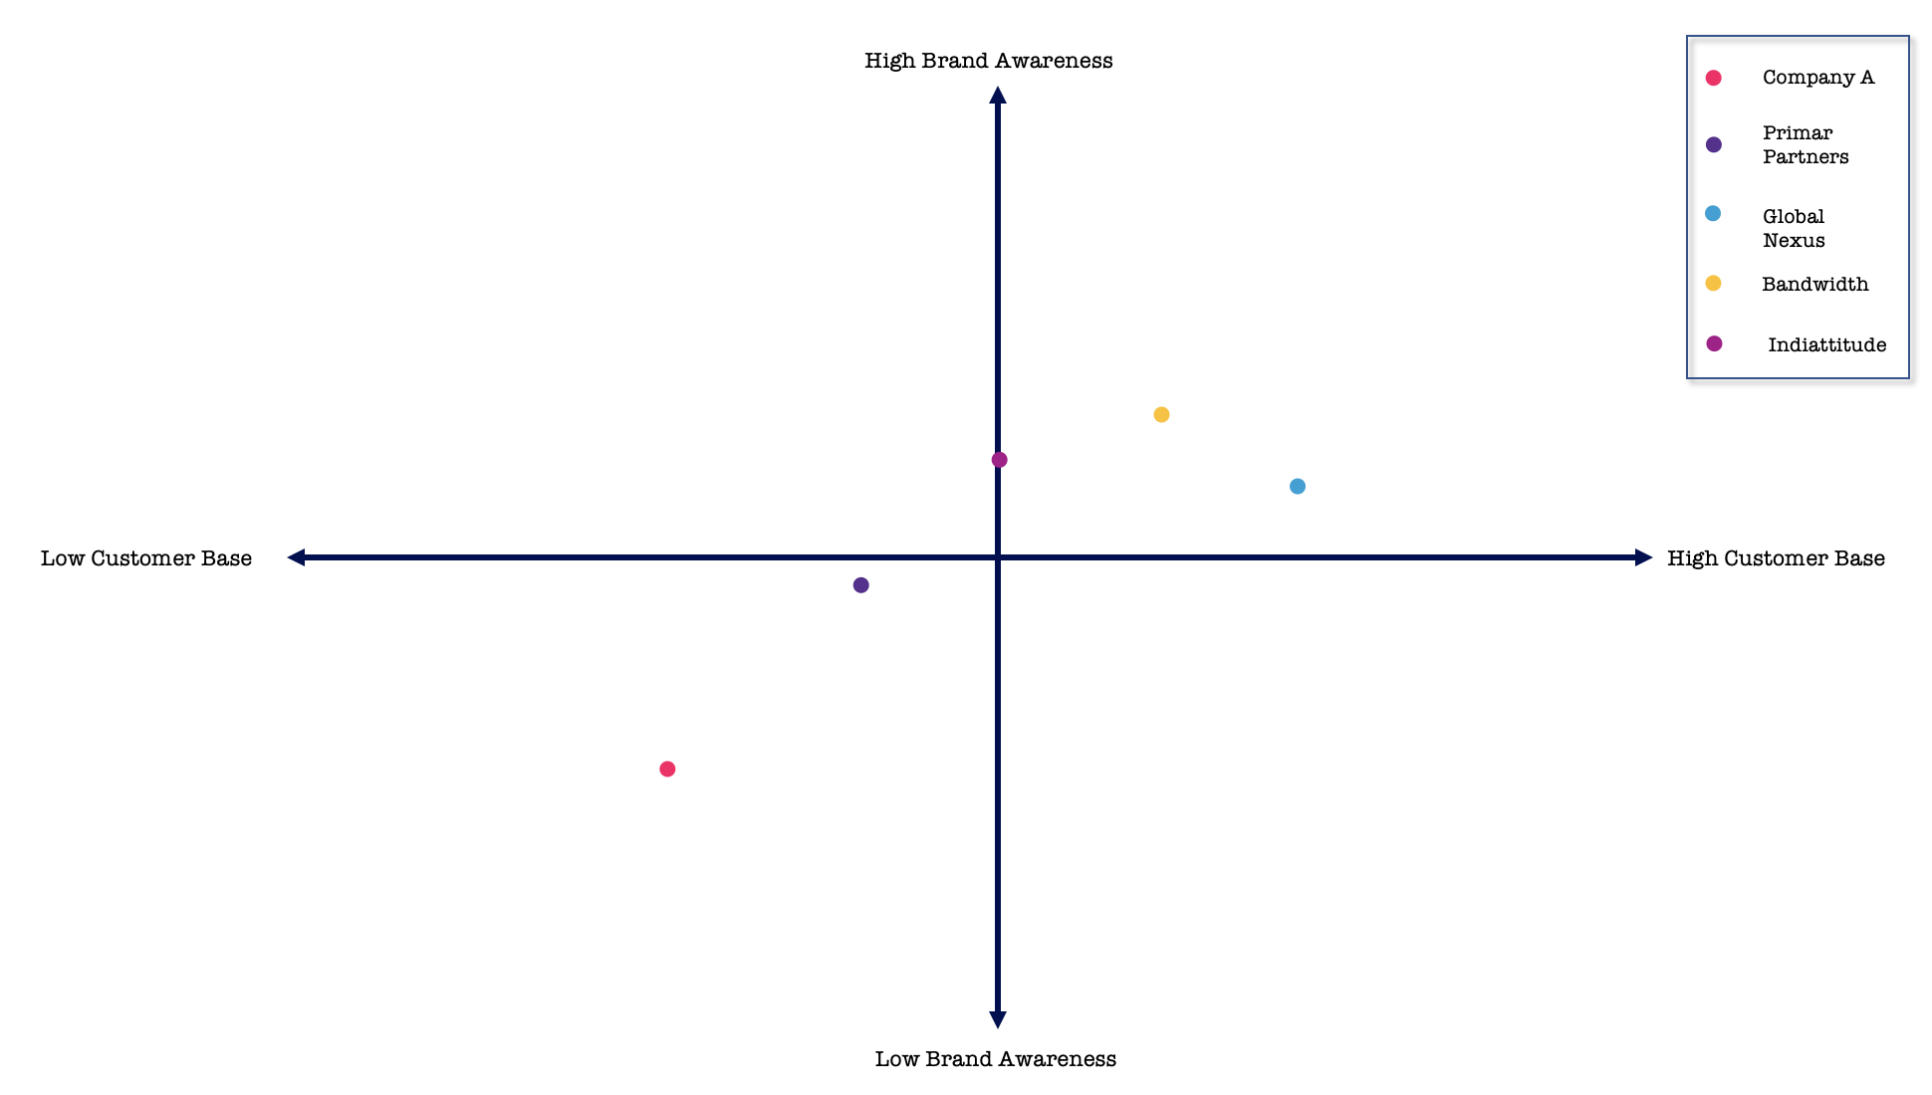
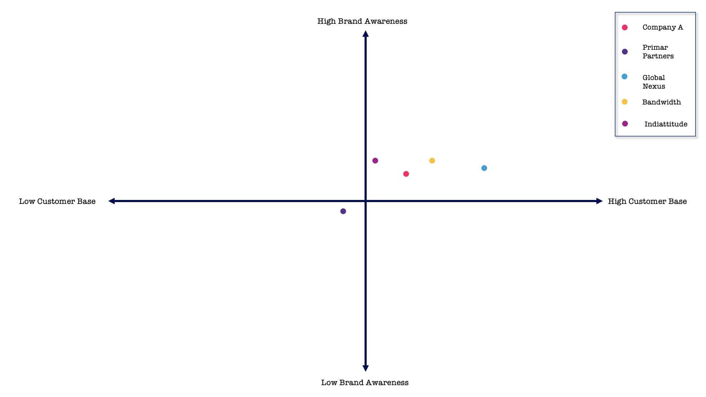
Disha Rattan
Event Marketing,
Company Name Not Disclosed (Company A)
Before
After
#2 Marketing

Slide 25
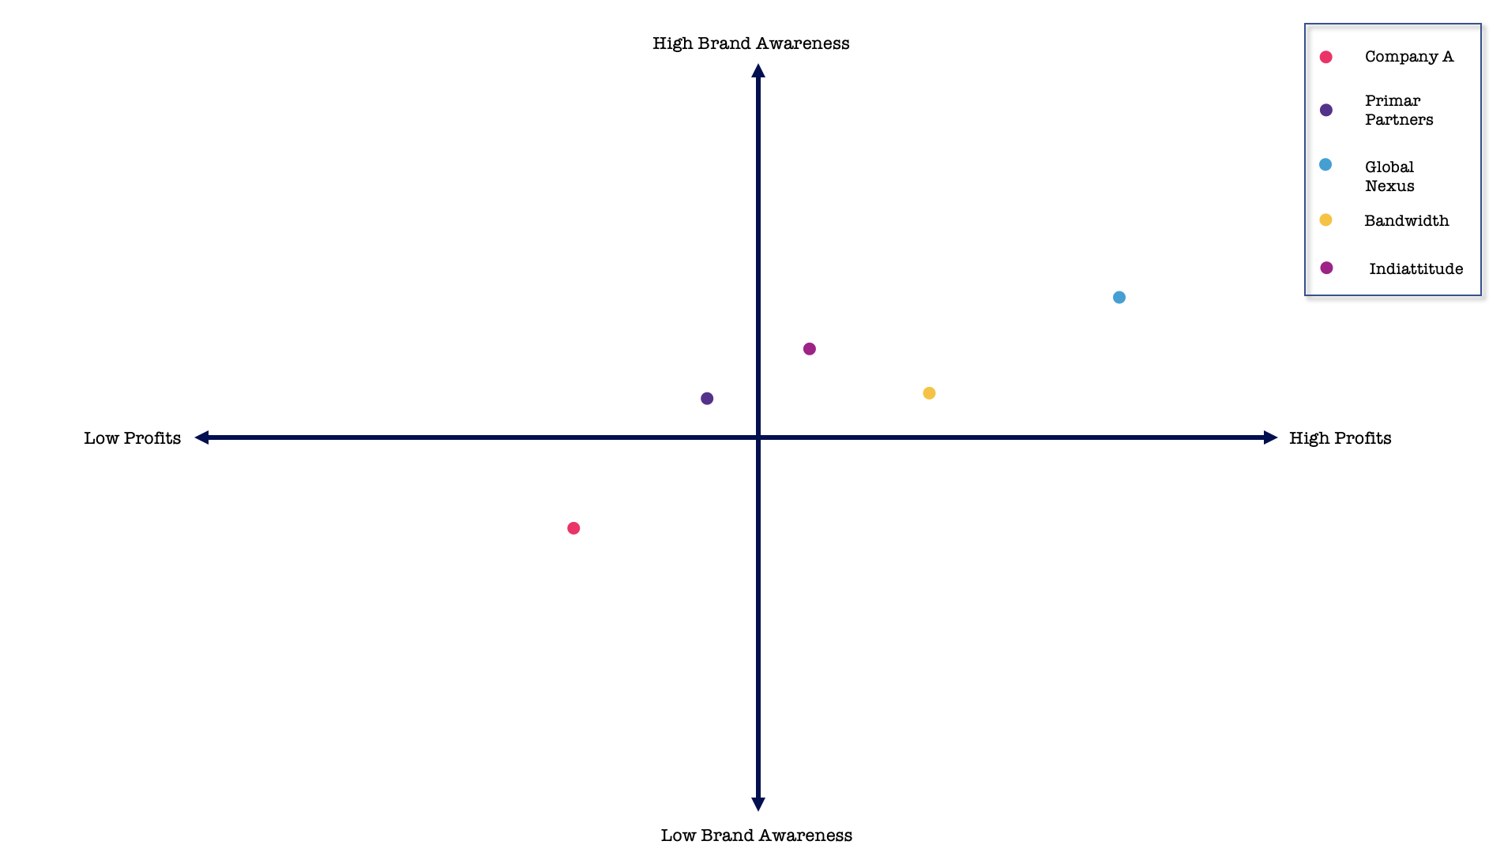
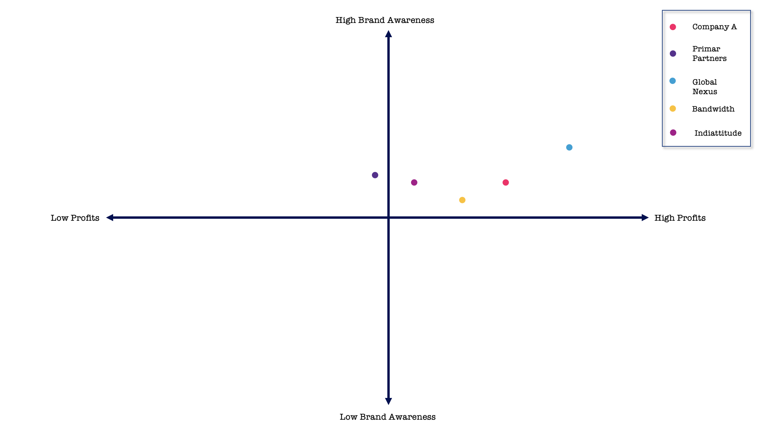
Disha Rattan
Event Marketing,
Company Name Not Disclosed (Company A)
Before
After
#2 Marketing

Slide 26
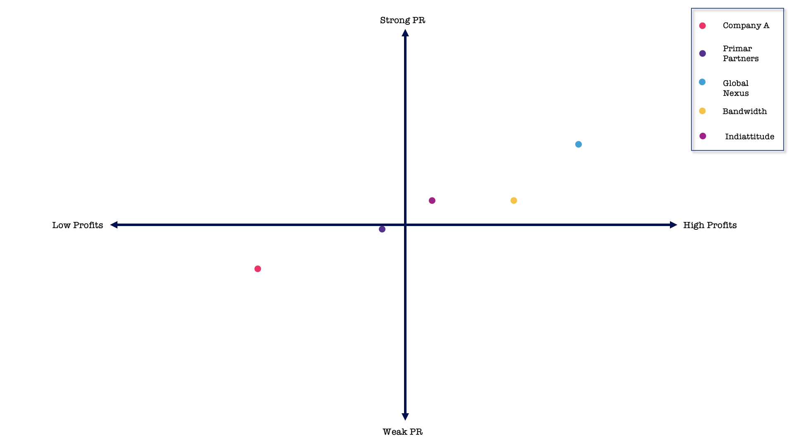
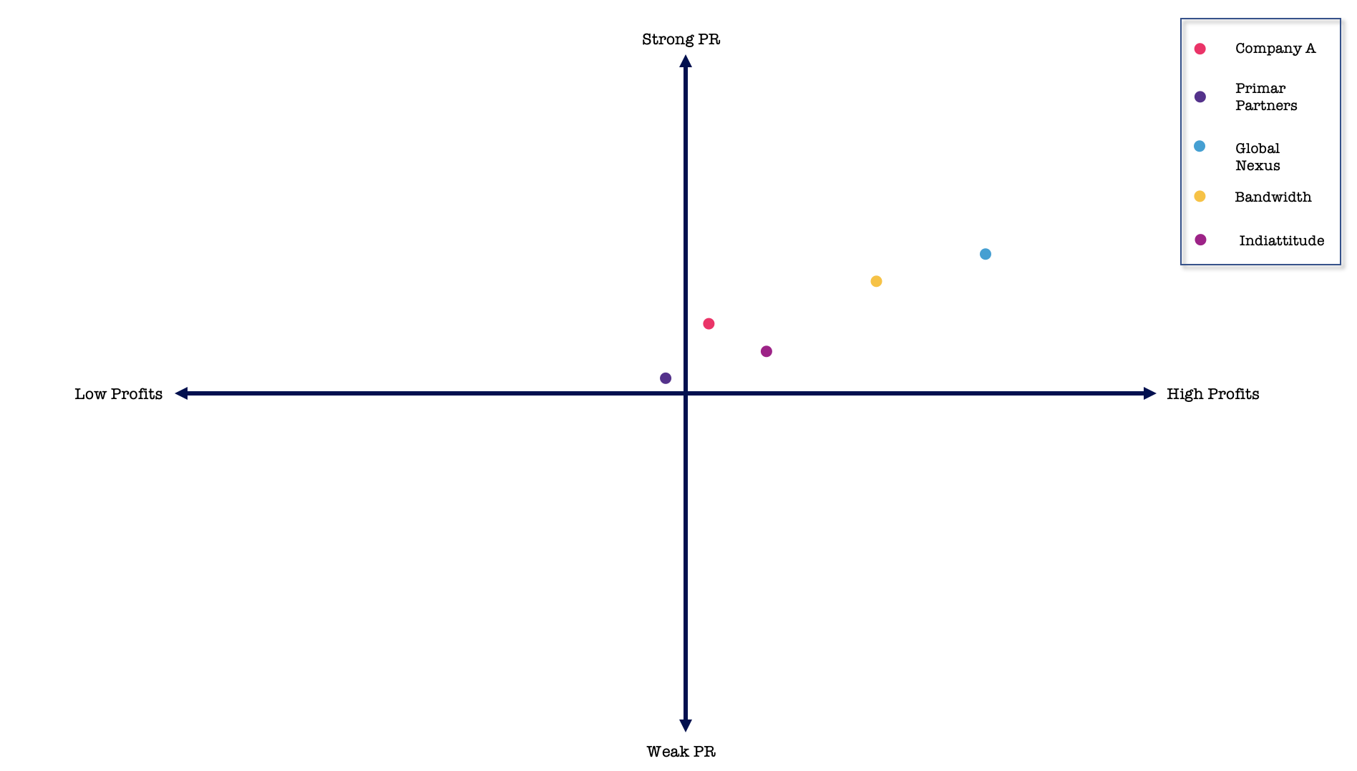
Disha Rattan
Event Marketing,
Company Name Not Disclosed (Company A)
Before
After
#2 Marketing

Slide 27
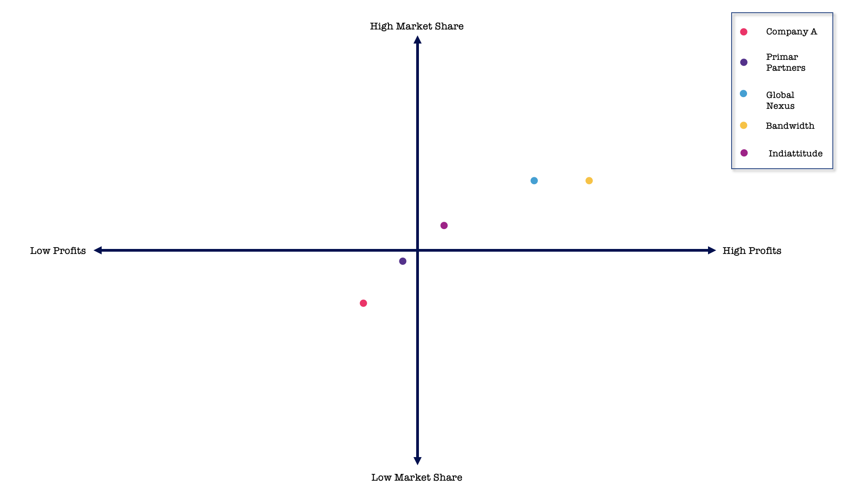
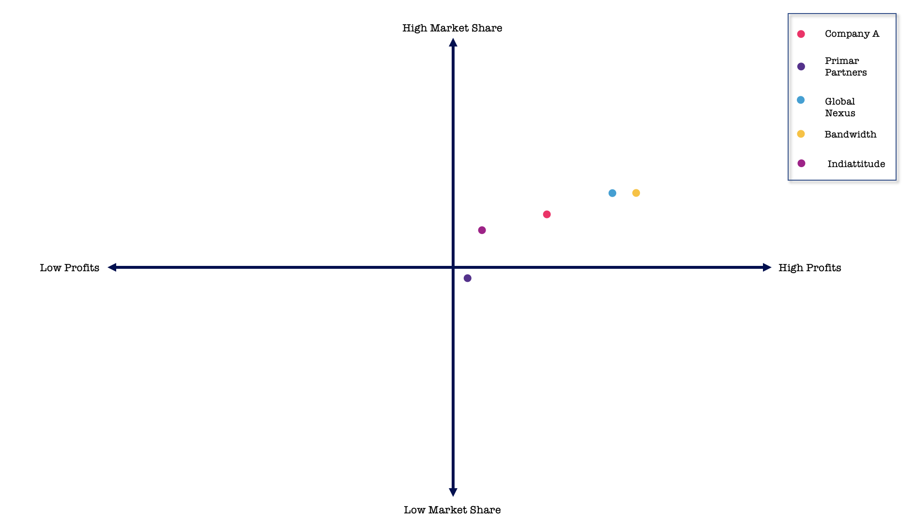
Disha Rattan
Event Marketing,
Company Name Not Disclosed
Before
After
#2 Marketing

Slide 28

Disha Rattan
Marketing/Digital
Marketing Strategies

Slide 29
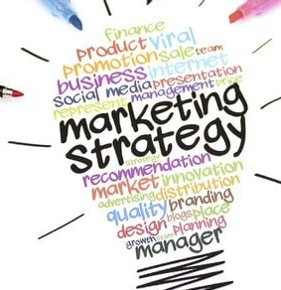
Disha Rattan
Why is a marketing strategy Important?
A marketing strategy is a company's overall plan to reach out to potential consumers and convert them into customers of their goods or services.
A marketing plan assists you in developing products and services that have the highest possibility of earning a profit. It facilitates setting the right price for a product or service based on market research, helps in selecting distribution channels to maximise marketing effectiveness, and creating a brand image. In addition, a marketing strategy assists departments in working more smoothly with one another because they are all working toward the same goal.
What are the strategies that I follow?
A marketing strategy is a one-of-a-kind formula for each business, based on a knowledge of its goal, its position in the marketplace, and its carefully chosen markets.

Slide 30




Disha Rattan
4 P’s of Marketing
Product:
A product is a good or service that a firm provides to its consumers. A product should ideally meet an existing customer's need. Alternatively, a product may be so appealing that buyers think they must have it, resulting in new demand.
Place:
When a firm makes a location choice, it is attempting to identify where it should sell a product and how to get the product to the market. Business leaders' ultimate objective is to bring their products in front of the people who are most inclined to buy them.
Price:
The cost that customers pay for a product is referred to as its price. Marketers must relate the price to the true and perceived worth of the product, but they must also consider supplier costs, seasonal reductions, and rivals' prices.
Promotion:
Advertising, public relations, and promotional strategy are all examples of promotion. The objective of product promotion is to show customers why they need a product and why they should pay a specific amount for it.

Slide 31

Disha Rattan
Marketing/Digital
Marketing Strategies

Slide 32

Disha Rattan
What is Marketing?
Marketing is the purposeful stimulation of demand for and sales of goods and services, which includes the selection of a target audience as well as the qualities or themes to stress during advertising campaigns. Marketing also includes factors such as attractive product design and packaging, pricing selection, discounts, warranties, and returns, product placement in the media and influencers, and agreements with third-party suppliers to raise brand awareness and loyalty.

Slide 33
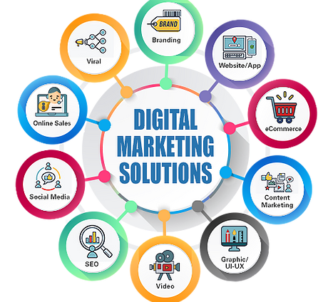
Disha Rattan
What is Digital Marketing?
The promotion of products or brands using electronic devices or the internet is known as digital marketing. In a nutshell, digital marketing refers to any marketing activity that uses an electronic device or the internet. Businesses use digital channels to communicate with existing and prospective consumers, such as search engines, social media, email, and other websites.

Slide 34
Disha Rattan
Aspects
Advertising: A method of communicating with consumers of a product or service to inform or influence those who receive it.
Copywriting: Creation of messages featured advertising, email newsletters, social media posts, product descriptions, and other marketing materials customised to a specific audience while including the brand's voice.
Market Research: The process of assessing the feasibility of a new service or product via direct consumer study.
CRM: A a set of strategies that enable businesses to manage their relationships with existing and potential customers.
Media Relations: Collaborating with the media to inform the public about a company's mission, policies, and practices in a constructive, consistent, and trustworthy manner
Event Planning: Planning and coordinating an event to promote a product or service of a brand
Direct Marketing: A targeted promotion approach in which information about a company, product, or service is presented to the customer without an advertising intermediary
SEO: The technique of increasing the quality and quantity of website traffic from search engines. SEO focuses on unpaid traffic rather than direct or sponsored visitors

Slide 35
Disha Rattan
Aspects
Internet Marketing: Methods for marketing products and services via the internet and other digital channels
Marketing Communications: The messaging and medium that marketers employ to communicate with their target audiences
Product Development: All steps involved in developing a product from concept to market release and beyond
Product Management: An organisational role responsible for new product creation, business rationale, planning, verification, forecasting, pricing, product launch, and marketing of a product throughout the product lifecycle
Supply Chain Management: Managing the flow of products and services between enterprises and locations, including raw material transportation and storage, work-in-process inventories, and final products, as well as end-to-end order fulfilment
Graphic Design: Creation of visual content to communicate the company’s messages to it existing and potential customers
Merchandising: Any technique that aids in the selling of products to a retail customer
Branding: The process of imbuing meaning into a particular organisation, company, product, or service by developing and moulding a brand in the eyes of customers

Slide 36
Disha Rattan
Aspects
Loyalty Marketing: A strategic marketing technique in which a firm focuses on expanding and keeping existing consumers through incentives
Sales Management and Support: Process of hiring, training, and motivating sales personnel, as well as managing activities throughout the sales department and creating a coherent sales strategy that produces corporate revenue
Strategic Planning: The process through which an organisation defines its strategy or direction and decides how to allocate its resources to accomplish that strategy. It may also include control systems for directing strategy execution.
Promotion: Any sort of marketing communication intended to inform target audiences about the relative advantages of a product, service, brand, or problem, which is usually persuasive in nature
Public Relations: The activity of managing and releasing information from an individual or organisation to the public to influence public opinion of that individual or organisation
SEM: A method or strategy used to increase the visibility of a website in search engine results
Pricing: The decision-making process involved in determining the worth of a product or service

Slide 37
Disha Rattan
Types
Influencer Marketing: A kind of social media marketing that relies on product endorsements and mentions from influencers/individuals who have a large social following and are regarded as experts in their field
Relationship Marketing: A marketing strategy derived from direct response marketing campaigns that prioritise client retention and happiness above sales transactions
Viral Marketing: A marketing approach that promotes a product primarily through existing social networks on various social media platforms. It refers to how customers share information about a product with others and how frequently
Green Marketing: A wide variety of actions, including product modification, modifications to the manufacturing process, sustainable packaging, and advertising adjustments to market products assumed to be safe for the environment
Keyword Marketing: A well-known method for boosting SEO efforts It serves as a link between the information on a website and what visitors are looking for on a search engine
Guerrilla Marketing: The employment of new or unusual tactics to increase sales or generate interest in a brand or business. These approaches are frequently low- or no-cost and they entail the broad usage of more personal encounters or viral social media messaging

Slide 38
Disha Rattan
Types
Outbound Marketing: A product's promotion by ongoing advertising, promotions, public relations, and sales. It is seen as a bothersome variation on the standard method of marketing in which businesses focus on acquiring clients through advertising
Inbound Marketing: A strategy that employs a variety of pull marketing, including content marketing, blogs, events, SEO, social media, and others, to raise brand recognition and attract new customers. Because inbound marketing is solely based on organic leads, it depends on brains rather than money
Affiliate Marketing: A sort of performance-based marketing in which a company compensates one or more affiliates for each visitor or client brought in by the affiliate's marketing efforts
Sponsorship Marketing: Sponsorship is when your company contributes to an event or institution for mutual benefit. Sponsorship marketing uses that sponsorship in a structured effort to advertise your business, particularly in your local region

Slide 39

Disha Rattan
Marketing/Digital
Marketing Strategies

Slide 40
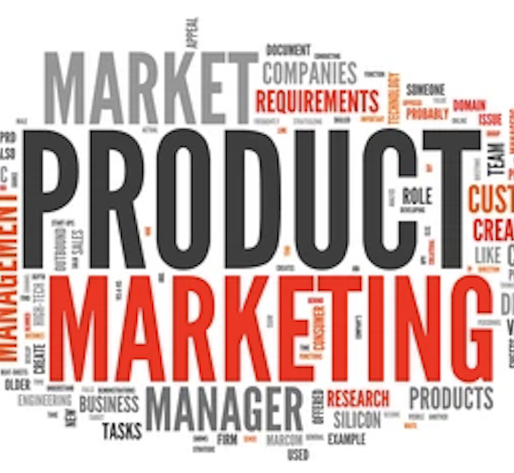
Disha Rattan
What is Product Marketing?
The process of bringing a product to market is known as product marketing. This involves determining the product's positioning and message, releasing it, and ensuring that salespeople and customers understand it. Product marketing seeks to increase product demand and utilization.

Slide 41
Disha Rattan
Aspects
Product positioning: The goal of messaging and positioning is to learn what makes your market tick and then frame your offer in a way that connects with your consumers.
Product Launch: Whether it's a little feature update or a full-fledged new product, launches represent the foundation of a product's marketing position. Product marketing stands at the crossroads of several departments, including sales, product, customer success, finance, and engineering, ensuring that everyone is up to date, pulling their weight, and enabled.
Sales Collateral: Sales collateral comes in a variety of formats, and the extent of what is necessary is determined primarily by the type of launch. For example, a minor feature change that affects only a subset of existing customers may only necessitate
a little language change on the website and a quick meeting with Sales and Customer Success to convey the information.
Market Research: It is important to have an in-depth understanding of the market and the consumers that you are marketing your product to, in order to make sure that there is a considerable demand for your product.
Reporting: It is important to have measurable KPI’s for your product marketing efforts to know which strategies are benefiting you and which are not.

Slide 42
Disha Rattan
Aspects
Content Marketing: Blogs, whitepapers, and case studies, as well as social media posts, product manuals, and sales one-pagers, are all possibilities.
Website Management: Ensuring that new features and items are reflected throughout the site, elements related to messaging and placement are up to date and operational. Everything has been optimized, including user experience and product usage, and in-app messages are planned and functional.
Product Roadmap: The product roadmap is the overall guidance created from consumer and data-driven intel.
Customer Onboarding: First impressions are essential, and a great onboarding process ensures that everyone gets off to a good start and has everything they want to get the most out of a product.

Slide 43

Disha Rattan
Marketing/Digital
Marketing Strategies

Slide 44
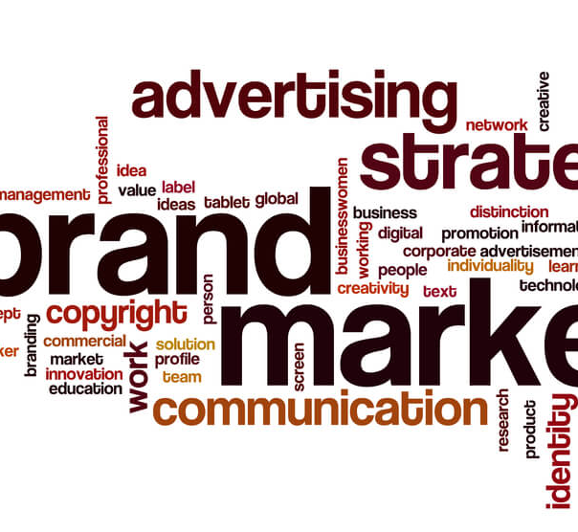
Disha Rattan
What is Brand Marketing?
It is a long-term, strategic plan for increasing a brand's awareness and reputation over time. The objective of brand marketing is to build a loyal consumer base that grows over time. This is accomplished through expressing the brand's identity and values in relevant and engaging ways continuously.

Slide 45
Disha Rattan
Aspects
Developing Brand Image: Making a brand identifiable by using visual components such as emblems, logos, colors, packaging, and so on.
Raising Brand Awareness: Making people remember and identify your brand and goods
Developing Brand Loyalty: Creating a loyal client base that will remain with the business in the long run
Gathering Brand Ambassadors: Increasing the amount of people who recommend your product or service.
Creating Brand Engagement: Having consumers connect with your brand by visiting your website, leaving product reviews, or placing purchases

Slide 46

Disha Rattan
Marketing/Digital
Marketing Strategies

Slide 47
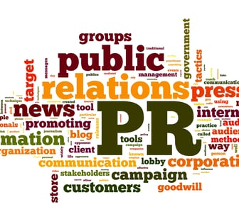
Disha Rattan
What is PR?
PR is an abbreviation for "public relations." It refers to an organisation's strategic communication with the public to preserve or nurture its public image or respond to the public conversation. Public relations is utilised not just to influence a narrative after it has occurred but also to create that story in the first place.

Slide 48
Disha Rattan
Aspects
Relationships: Public relations is described as the managerial role of studying, interacting, and collaborating with the general public to develop mutually beneficial partnerships. Because a company is ultimately about its connections with its clients, its success is determined by how successfully it manages those relationships and collaborates with important stakeholders. Therefore, every organisation needs a public relations plan to connect with its core audiences, manage their expectations, and develop its brand's authority in its niche.
Reputation: A company is dependent on its reputation. In today's highly competitive industry, a company's reputation is its most valuable asset.
You will have more leads if you have trust and authority. The company's image is what sets it apart from the competitors, and a solid public relations plan aids in understanding, supporting, and influencing public opinion and behaviour.
Communication: Public relations is a strategic communications method that enables businesses and their consumers to build mutually beneficial partnerships. Companies place a high value on communication to attract, convert, and delight consumers. Their firm will fail if they do not convey their goal and the benefits of their products and services to consumers.

Slide 49
Disha Rattan
Types
Media Relations: It includes preparing press releases, organising interviews, and holding press conferences. The objective is to produce favorable coverage for your company or product. You essentially want the media to perform your promotion for free.
Community Relations: Community engagement helps in strengthening a company's ties to the community. This is done to get local support for a project, such as constructing a new manufacturing plant, 'giving something back,' which improves the company's ethical reputation, and generating interest in your products or services.
Corporate and Social Responsibility:It enhances the company's reputation for ethics, environmental stewardship, and community and charitable activities. This aspect of public relations may have a significant impact on an organisation's business operations.
Public Affairs: Also known as lobbying, it is the process of cultivating relationships with politicians, the government, and other key decision-makers such as civil servants, think tanks, trade associations, and business groups to campaign for a change in legislation or positioning.

Slide 50
Disha Rattan
Types
Strategic Communications: It is about sending coordinated messages that assist an organisation in achieving its goals, rather than simply disseminating information for the sake of sending it. It is about understanding a company's goals and ensuring that all communication effort supports those goals.
Employee Communications: Employees may be the most powerful brand advocates for a company. As a result, businesses must establish programs that keep staff motivated and informed. Employee communications have a role in this. It is your responsibility to ensure that your employees are pleased, driven, and appreciated.
Crisis Management: When a faulty product must be recalled, a founder gets into an ugly dispute with someone on social media, or an employee accuses the firm of wrongdoing, crisis management is one of the sorts of public relations required. Any of these issues might jeopardise your company's reputation and must be handled as soon as feasible.

Slide 51

Disha Rattan
Marketing/Digital
Marketing Strategies

Slide 52
Disha Rattan
Content Marketing: It focuses on developing and disseminating information relevant to consumers' requirements to attract individuals who are most aligned with — and likely to buy — the product or service. Because communication is continual, material may be modified to reflect what you learn about leads over time and can take many forms, including infographics, websites, podcasts, videos, blogs, white papers, webinars, and eBooks.
Inbound Marketing: By creating and distributing relevant content, inbound marketers capture customers' attention and draw them to a company's website. Inbound attracts people rather than irritating them with interruptive traditional advertising since the message is relevant and arrives in the right place at the right time.
Social Media Marketing: It emphasises on providing people with quality information that they want to share on social media, leading to greater visibility and website traffic. Social media sharing of material, videos, and photos also impact SEO efforts since they frequently enhance relevancy in search results inside social media networks such as Facebook, Twitter, LinkedIn, YouTube, and Instagram and search engines such as Google and Yahoo.
Search Engine Optimisation: It is the process of boosting awareness of and traffic to a specific website by ensuring that it shows among the top unpaid search results on search engines such as Google and Yahoo.

Slide 53
Disha Rattan
Earned Media and PR: It is publicity generated by means apart from paid advertising. A social media endorsement, word of mouth, television or radio mention, newspaper story, or an editorial are all examples of earned media and PR. It cannot be purchased or possessed in the same way that traditional advertising can.
Referral Programs: It is an umbrella term for a systematic method undertaken by businesses to incentivise individuals to inform others about their products or services. Implementing particular affiliate programs, customer referral programs, and partner programs into a marketing strategy framework is intended to provide existing consumers with immediate credibility in order to increase a client base.
PPC: In this case, a company purchases/sponsors a link that appears as an advertisement in search engine results when keywords related to their product or service are searched. Then, when the ad is clicked, the firm pays a nominal charge to the search engine (or other third-party hosts) for the visitor.
Account Based Marketing and Retargeting: It is a B2B approach that employs highly customized advertising to target a specific set of accounts. It delivers various benefits to marketing and sales teams, including a quicker sales process, cost-effectiveness, and more efficient use of marketing resources.

Slide 54
Disha Rattan
Industry Events: Industry events, both in-person and online, continue to be a popular B2B networking tool since they bring firms from a specific sector together in one area, whether physical or virtual, to interact and display their latest goods and services. These shows, which are rarely open to the public, provide companies with the opportunity to establish or strengthen relationships with key industry partners, customers, and prospects; identify market trends and opportunities, and gain an understanding of what their competition is offering in the market.
Conversational Marketing: It is real-time engagement with prospects and customers via a chatbot, or live chat puts the correct information in front of them at the right moment, and follow-up inquiries are answered straight away. Personalised, relevant involvement significantly enhances the user experience, boosting the chance of recommendations from satisfied consumers.
Email Marketing: Email marketing is a powerful tool for nurturing and converting leads. It is an automated procedure that targets individual prospects and consumers with the objective of influencing their purchase decisions.
Storytelling: It employs a well-known communication style to elicit emotional responses from customers. Rather than simply spewing statistics and figures, storytelling helps you construct a memorable story about who your organisation is, what it does, how it solves issues, what it values, and how it engages and contributes to its community and the wider public.

Slide 55
Disha Rattan
Paid Media Advertising: Paid media is a strategy used by businesses to increase website traffic through paid advertising. Pay-per-click (PPC) links are one of the most common strategies. In essence, a corporation purchases a link that shows as an advertisement in search engine results when terms relating to their product or service are searched.
Internet Marketing: It integrates online and email marketing to promote and boost e-commerce sales. Social media platforms may also be used to boost brand visibility and advertise items and services. These efforts are often utilised in tandem with traditional advertising mediums such as radio, television, and print.
Direct Selling: It markets and sells items directly to consumers. In this approach, sales representatives develop face-to-face connections with customers by showing and selling items outside of retail venues, typically in the customer's house.
Point-of-Purchase Marketing: It markets and sells items directly to consumers. In this approach, sales representatives develop face-to-face connections with customers by showing and selling items outside of retail venues, typically in the customer's house.

Slide 56
Disha Rattan
Cause Marketing: It capitalises on and improves brand reputation. Cause marketing is a collaborative effort between a for-profit company and a non-profit entity to promote and benefit social and other humanitarian causes.
Co-branding and Affinity Marketing: It is a marketing strategy in which two or more companies collaborate to promote and sell a single product or service. The brands offer their collective reputation to improve customers' perceptions of the value of the product or service, making them more inclined to purchase and ready to pay more at retail.

Slide 57
Disha Rattan
It is safe to say that marketing plays a very important role in any business. In fact, as stated by Milan Kundera, “Business has only two functions- marketing and innovation.”

Slide 58
Disha Rattan
Thank you!

